Slide 1
The Greek Letters
Chapter 17

Slide 2
Example (Page 359)
A bank has sold for $300,000 a European call option on 100,000 shares of a non-dividend- paying stock
S₀ = 49, K = 50, r = 5%, σ = 20%,
T = 20 weeks, μ = 13%
The Black-Scholes-Merton value of the option is $240,000
How does the bank hedge its risk to lock in a $60,000 profit?

Slide 3
Naked & Covered Positions
Naked position
  Take no action
Covered position
  Buy 100,000 shares today
What are the risks associated with these strategies?

Slide 4
Stop-Loss Strategy
This involves:
  Buying 100,000 shares as soon as price reaches $50
  Selling 100,000 shares as soon as price falls below $50

Slide 5
Stop-Loss Strategy continued
Ignoring discounting, the cost of writing and hedging the option appears to be max(S₀−K, 0). What are we overlooking?

Slide 6
Greek Letters
Greek letters are the partial derivatives with respect to the model parameters that are liable to change
Usually traders use the Black-Scholes-Merton model when calculating partial derivatives
The volatility parameter in BSM is set equal to the implied volatility when Greek letters are calculated. This is referred to as using the “practitioner Black-Scholes” model

Slide 7
Delta (See Figure 17.2, page 363)
Delta (Δ) is the rate of change of the option price with respect to the underlying
Option
price
Slope = Δ = 0.6
B
A
Stock price

Slide 8
Hedge
Trader would be hedged with the position:
  short 1000 options
  buy 600 shares
Gain/loss on the option position is offset by loss/gain on stock position
Delta changes as stock price changes and time passes
Hedge position must therefore be rebalanced

Slide 9
Delta Hedging
This involves maintaining a delta neutral portfolio
The delta of a European call on a non-dividend-paying stock is N (d ₁)
The delta of a European put on the stock is
[N (d ₁) – 1]

Slide 10
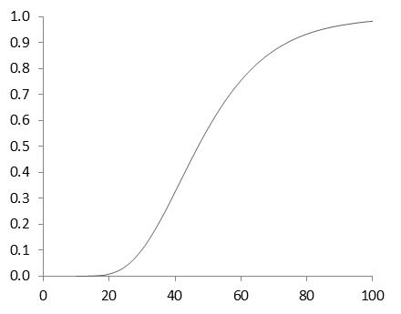
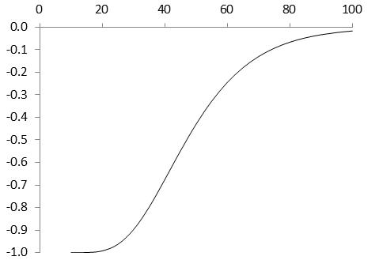
Delta of a Stock Option (K=50, r=0, σ = 25%, T=2, Figure 17.3, page 365)
Call
Put

Slide 11
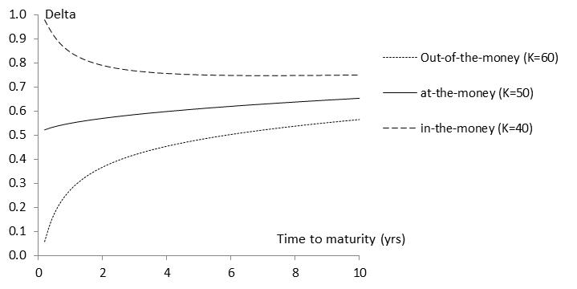
Variation of Delta with Time to Maturity(S₀=50, r=0, σ=25%, Figure 17.4, page 366)

Slide 12
The Costs in Delta Hedging continued
Delta hedging a written option involves a “buy high, sell low” trading rule

Slide 13
First Scenario for the Example: Table 17.2 page 366
Week | Stock price | Delta | Shares purchased | Cost (‘$000) | Cumulative Cost ($000) | Interest
0 | 49.00 | 0.522 | 52,200 | 2,557.8 | 2,557.8 | 2.5
1 | 48.12 | 0.458 | (6,400) | (308.0) | 2,252.3 | 2.2
2 | 47.37 | 0.400 | (5,800) | (274.7) | 1,979.8 | 1.9
....... | ....... | ....... | ....... | ....... | ....... | .......
19 | 55.87 | 1.000 | 1,000 | 55.9 | 5,258.2 | 5.1
20 | 57.25 | 1.000 | 0 | 0 | 5263.3

Slide 14
Second Scenario for the Example Table 17.3 page 367
Week | Stock price | Delta | Shares purchased | Cost (‘$000) | Cumulative Cost ($000) | Interest
0 | 49.00 | 0.522 | 52,200 | 2,557.8 | 2,557.8 | 2.5
1 | 49.75 | 0.568 | 4,600 | 228.9 | 2,789.2 | 2.7
2 | 52.00 | 0.705 | 13,700 | 712.4 | 3,504.3 | 3.4
....... | ....... | ....... | ....... | ....... | ....... | .......
19 | 46.63 | 0.007 | (17,600) | (820.7) | 290.0 | 0.3
20 | 48.12 | 0.000 | (700) | (33.7) | 256.6

Slide 15
Theta
Theta (Θ) of a derivative (or portfolio of derivatives) is the rate of change of the value with respect to the passage of time
The theta of a call or put is usually negative. This means that, if time passes with the price of the underlying asset and its volatility remaining the same, the value of a long call or put option declines

Slide 16
Theta for Call Option (K=50, σ = 25%, r = 0, T = 2, Figure 17.5, page 370)

Slide 17
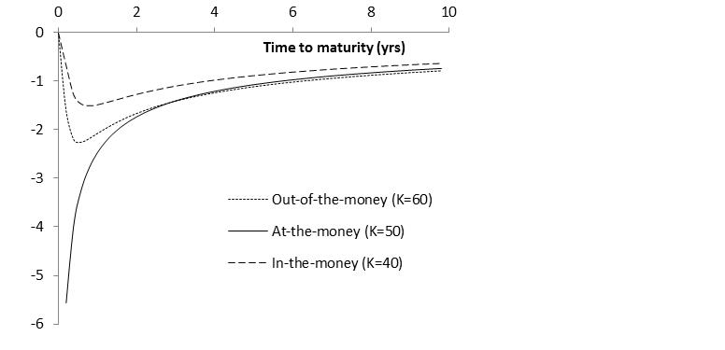
Variation of Theta with Time to Maturity (S₀=50, r=0, σ=25%, Figure 17.6, page 371)

Slide 18
Gamma
Gamma (Γ) is the rate of change of delta (Δ) with respect to the price of the underlying asset
Gamma is greatest for options that are close to the money

Slide 19
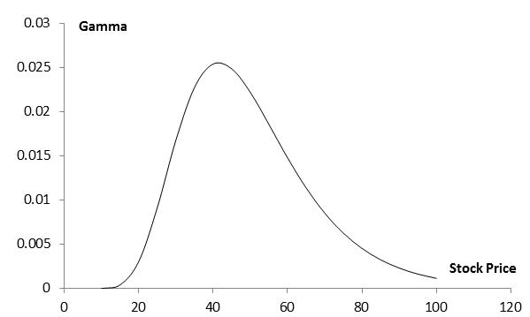
Gamma for Call or Put Option: (K=50, σ = 25%, r = 0%, T = 2, Figure 17.9, page 375)

Slide 20
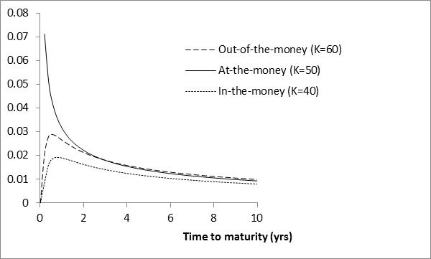
Variation of Gamma with Time to Maturity (S₀=50, r=0, σ=25%, Figure 17.10, page 375)

Slide 21
Gamma Addresses Delta Hedging Errors Caused By Curvature
(Figure 17.7, page 372)
Call
price
C′′
C′
C
Stock price
S
S′

Slide 22
Interpretation of Gamma
For a delta neutral portfolio,
ΔΠ ≈ Θ Δt + ½ΓΔS ²
ΔΠ
ΔΠ
ΔS
ΔS
Positive Gamma
Negative Gamma

Slide 23
Relationship Between Delta, Gamma, and Theta
For a portfolio of derivatives on a non-dividend-paying stock paying

Slide 24
Vega
Vega (ν) is the rate of change of the value of a derivative with respect to implied volatility

Slide 25
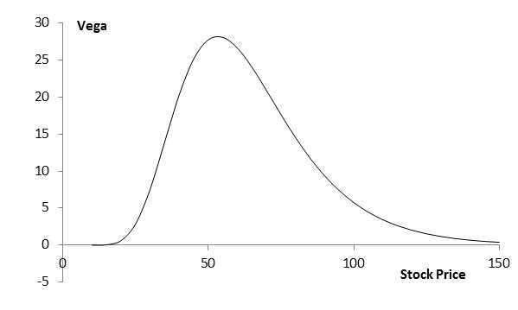
Vega for Call or Put Option (K=50, σ = 25%, r = 0, T = 2)

Slide 26
Managing Delta, Gamma, & Vega
Delta can be changed by taking a position in the underlying asset
To adjust gamma and vega it is necessary to take a position in an option or other derivative

Slide 27
Example
 | Delta | Gamma | Vega
Portfolio | 0 | −5000 | −8000
Option 1 | 0.6 | 0.5 | 2.0
Option 2 | 0.5 | 0.8 | 1.2
What position in option 1 and the underlying asset will make the portfolio delta and gamma neutral? Answer: Long 10,000 options, short 6000 of the asset
What position in option 1 and the underlying asset will make the portfolio delta and vega neutral? Answer: Long 4000 options, short 2400 of the asset

Slide 28
Example continued
 | Delta | Gamma | Vega
Portfolio | 0 | −5000 | −8000
Option 1 | 0.6 | 0.5 | 2.0
Option 2 | 0.5 | 0.8 | 1.2
What position in option 1, option 2, and the asset will make the portfolio delta, gamma, and vega neutral?
We solve
−5000+0.5w₁ +0.8w₂ =0
−8000+2.0w₁ +1.2w₂ =0
to get w₁ = 400 and w₂ = 6000. We require long positions of 400 and 6000 in option 1 and option 2. A short position of 3240 in the asset is then required to make the portfolio delta neutral

Slide 29
Rho
Rho is the rate of change of the value of a derivative with respect to the interest rate

Slide 30
Hedging in Practice
Traders usually ensure that their portfolios are delta-neutral at least once a day
Whenever the opportunity arises, they improve gamma and vega
As portfolio becomes larger hedging becomes less expensive

Slide 31
Scenario Analysis
A scenario analysis involves testing the effect on the value of a portfolio of different assumptions concerning asset prices and their volatilities

Slide 32
Greek Letters for European Options on an Asset that Provides a Yield at Rate q (Table 17.6, page 381)
Greek Letter | Call Option | Put Option
Delta
Gamma
Theta
Vega
Rho

Slide 33
Using Futures for Delta Hedging
The delta of a futures contract on an asset paying a yield at rate q is e^{(r-q)T} times the delta of a spot contract
The position required in futures for delta hedging is therefore e^{-(r-q)T} times the position required in the corresponding spot contract

Slide 34
Hedging vs Creation of an Option Synthetically
When we are hedging we take positions that offset delta, gamma, vega, etc
When we create an option synthetically we take positions that match delta, gamma, vega, etc

Slide 35
Portfolio Insurance
In October of 1987 many portfolio managers attempted to create a put option on a portfolio synthetically
This involves initially selling enough of the portfolio (or of index futures) to match the Δ of the put option

Slide 36
Portfolio Insurance continued
As the value of the portfolio increases, the Δ of the put becomes less negative and some of the original portfolio is repurchased
As the value of the portfolio decreases, the Δ of the put becomes more negative and more of the portfolio must be sold

Slide 37
Portfolio Insurance continued
The strategy did not work well on October 19, 1987...

